Slide 1
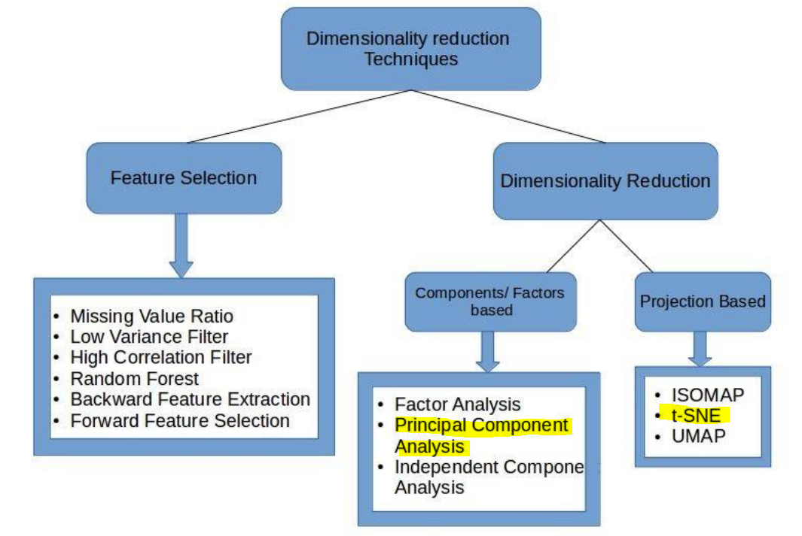

Slide 2
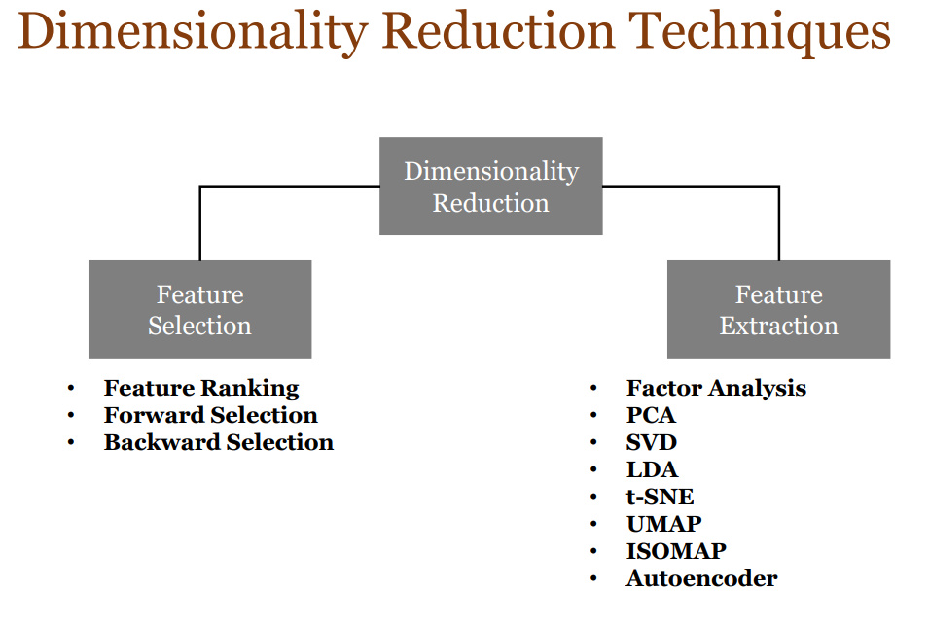
Dimensionality Reduction Techniques

Slide 3
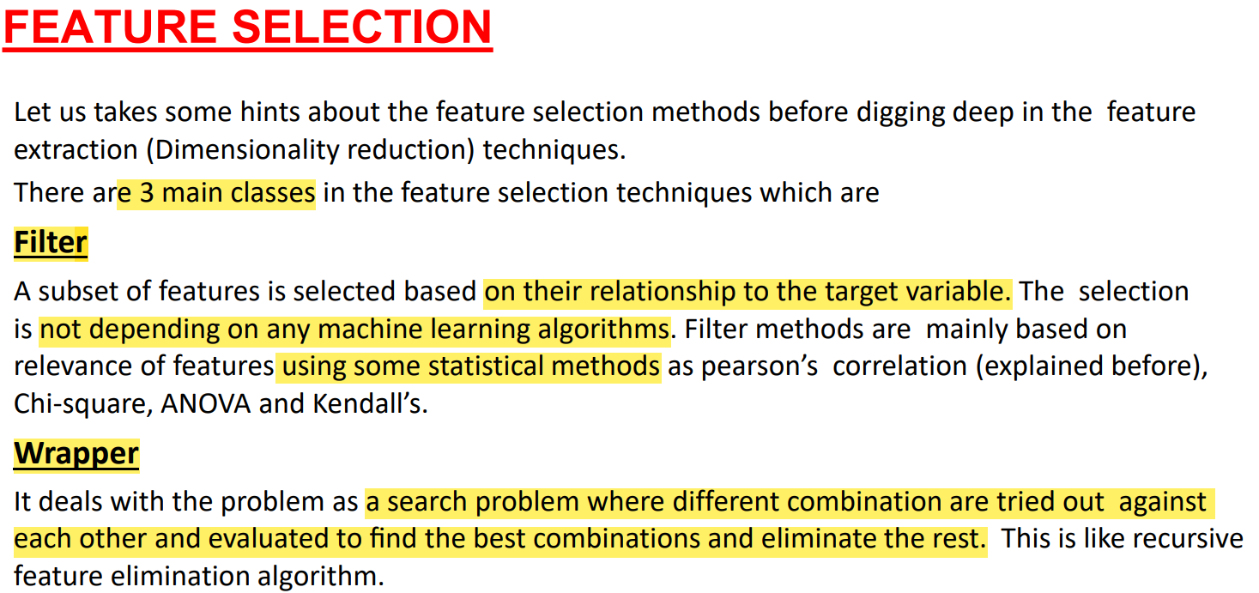
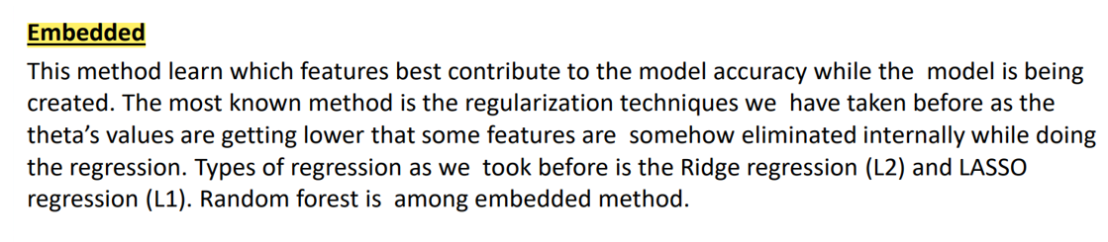

Slide 4
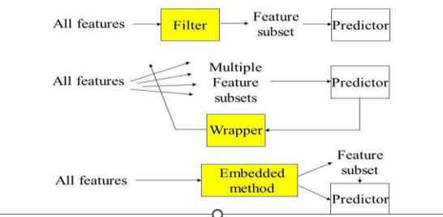

Slide 5
1. Filter Methods
Filter methods evaluate the relevance of features based on statistical measures and do not involve any machine learning models.
Variance Threshold: Removes features that have a variance below a certain threshold, as low variance often means low information.
Correlation Coefficient: Features that are highly correlated with the target variable are kept, while those with low correlation are removed.
Chi-Square Test: Used for categorical data; it tests the independence between each feature and the target variable.
Mutual Information: Measures the amount of information obtained about one random variable through another random variable.

Slide 6
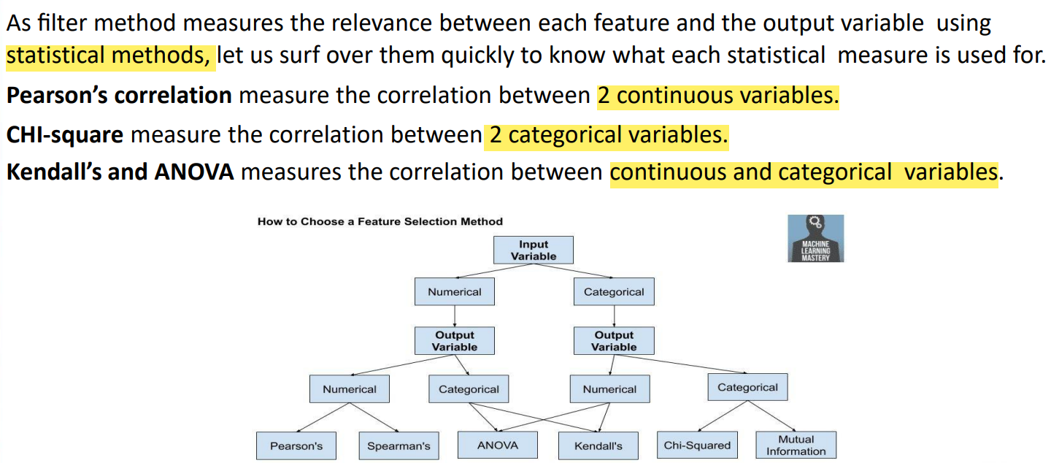

Slide 7
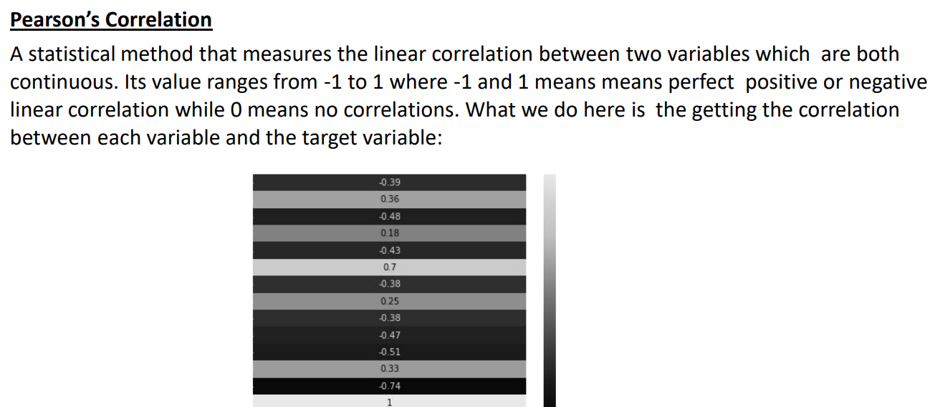

Slide 8
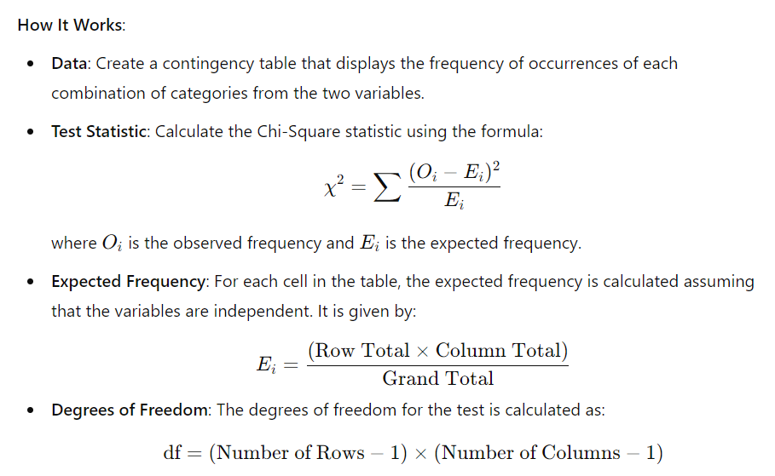
Chi square

Slide 9
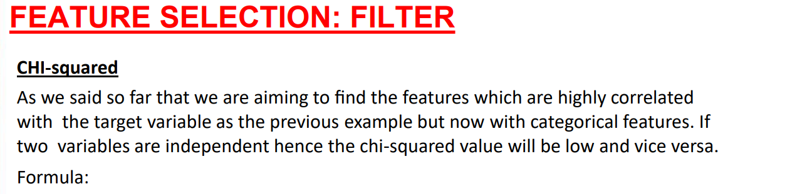
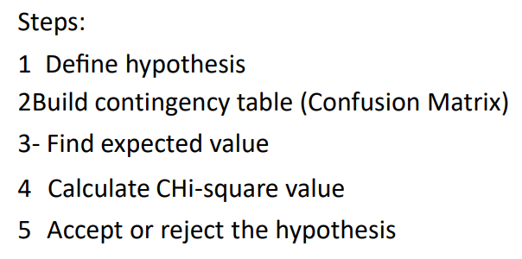
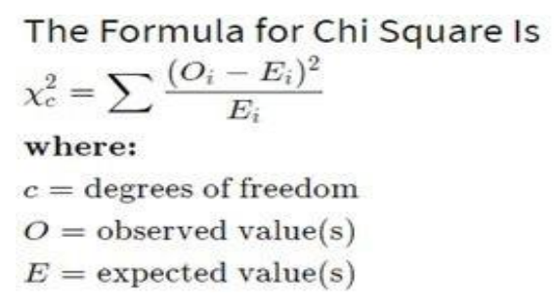

Slide 10
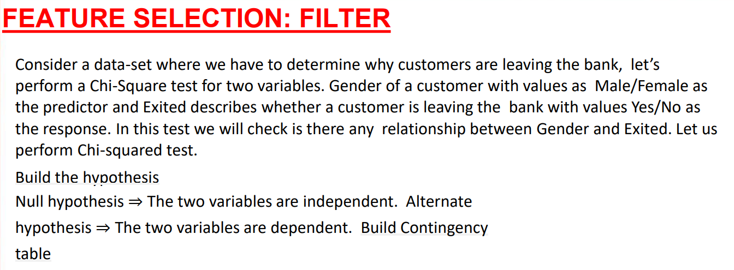
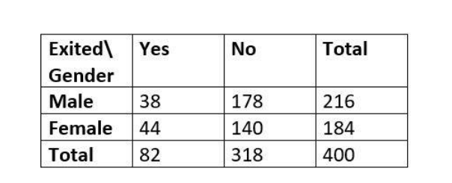

Slide 11
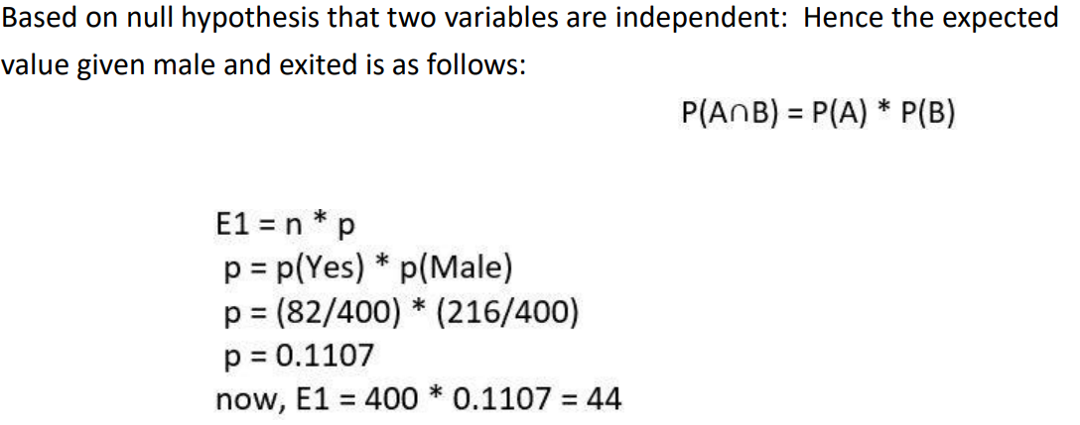

Slide 12
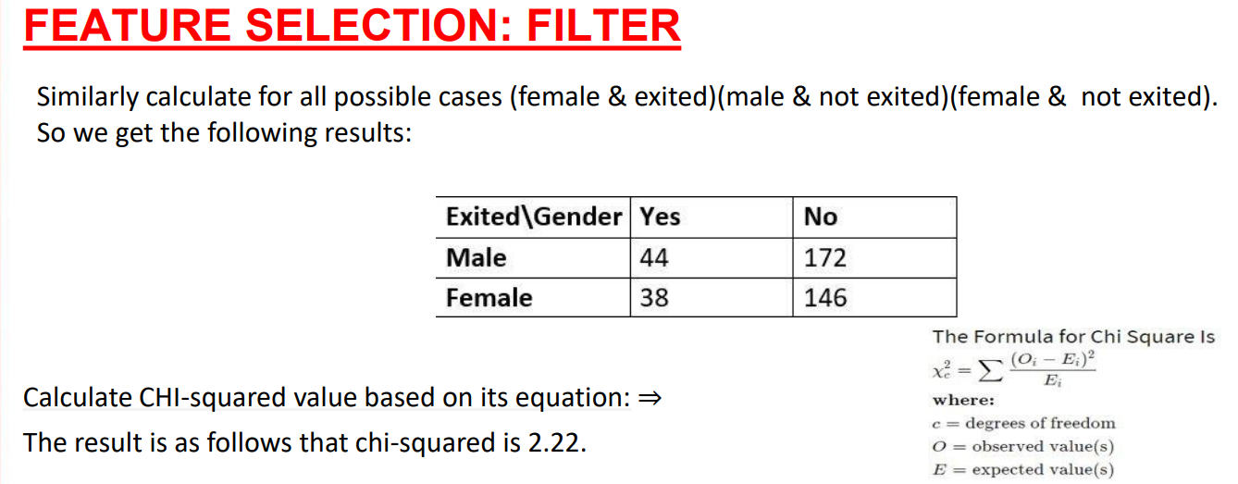
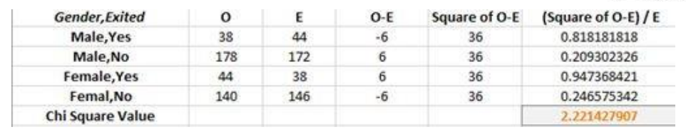

Slide 13
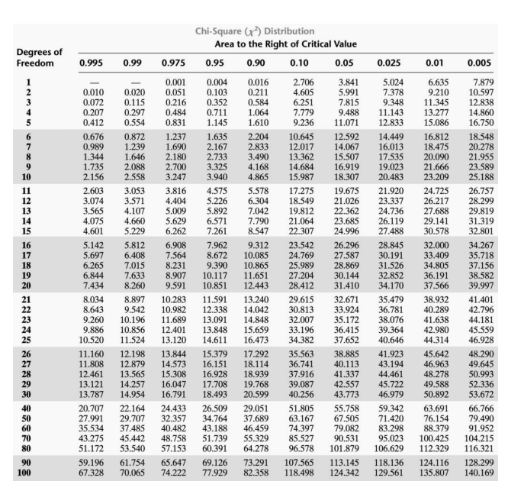

Slide 14
Chi square
Chi-Square Statistic: Measures how much the observed frequencies differ from the expected frequencies.
P-Value: If the p-value is less than the significance level (e.g., 0.05), reject the null hypothesis of independence.
Degrees of Freedom: Used to determine the critical value from the Chi-Square distribution table.
Expected Frequencies: Helps to understand how the data would look if there were no association between the variables.

Slide 15
Annova Feature selection
ANOVA (Analysis of Variance) is a statistical method used to compare the means of three or more groups to determine if there are any statistically significant differences between them.
In the context of feature selection, ANOVA can be used to evaluate the importance of each feature in relation to the target variable, particularly for classification tasks.
1. Objective of ANOVA for Feature Selection
Feature Importance: ANOVA can be used to assess the relevance of each feature with respect to the target variable. Features that have a significant effect on the target variable (i.e., features that lead to significant differences between groups) are considered important.
2. How ANOVA Works for Feature Selection
Group Comparison: ANOVA tests whether the means of different groups (defined by the target variable) are statistically different. If the variance between groups is significantly larger than the variance within groups, the feature is considered important.
F-Statistic: The test statistic for ANOVA is the F-statistic, which measures the ratio of variance between groups to the variance within groups. A higher F-statistic indicates greater importance of the feature.

Slide 16
Steps to Use Annova Feature selection
1. Preprocess the Data :
Ensure that the features and target variable are in the appropriate format. The target variable should be categorical, and features should be numerical.
2. Apply ANOVA :
Use ANOVA to evaluate each feature with respect to the target variable. The f_classif function from sklearn.feature_selection can be used for this purpose.
3. Select Features :
Rank features based on their ANOVA F-values. Features with higher F-values are more significant and are selected for the model.

Slide 17
Kendall Feature selection
a statistical measure used to assess the correlation between two variables.
It is often used in feature selection to evaluate the strength and direction of the relationship between features and a target variable.
In the context of feature selection, Kendall’s Tau can be used to rank features based on their correlation with the target variable.
Definition: a non-parametric statistic used to measure the ordinal association between two variables. It assesses the strength and direction of the monotonic relationship between the variables.
Range: The value of Kendall’s Tau ranges from -1 to 1, where:
  1 indicates a perfect positive correlation.
  -1 indicates a perfect negative correlation.
  0 indicates no correlation.

Slide 18
2. Wrapper Methods
Wrapper methods use a predictive model to evaluate the importance of features. They are computationally expensive but often yield better results than filter methods.
Forward Selection: Starts with no features and adds one feature at a time, selecting the one that improves the model performance the most until no significant improvement is possible.
Backward Elimination: Starts with all features and removes the least important feature one at a time, based on model performance, until no further improvement is possible.
Recursive Feature Elimination (RFE): Iteratively builds the model, removing the weakest feature each time, and then ranks features by importance.

Slide 19
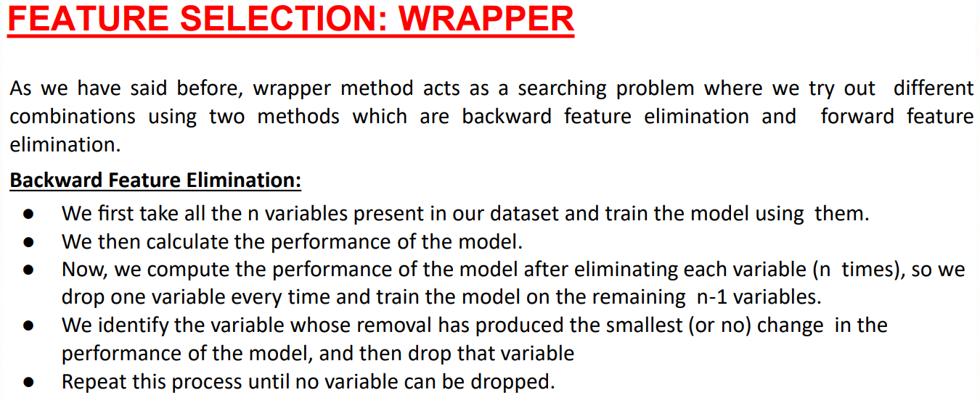

Slide 20
3. Embedded Methods
Embedded methods perform feature selection during the process of model training and are specific to the model being used.
LASSO (Least Absolute Shrinkage and Selection Operator): Adds a penalty equal to the absolute value of the magnitude of coefficients, shrinking some coefficients to zero, effectively selecting features.
Ridge Regression: Similar to LASSO but adds a penalty based on the square of the coefficients. It doesn’t perform feature selection as aggressively as LASSO.
Elastic Net: Combines LASSO and Ridge penalties to balance the benefits of both.
Tree-Based Methods: Decision trees and ensemble methods like Random Forest and Gradient Boosting inherently perform feature selection based on feature importance derived during training.

Slide 21
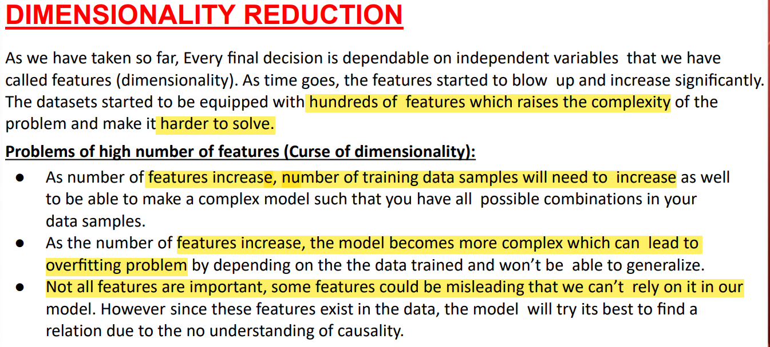

Slide 22
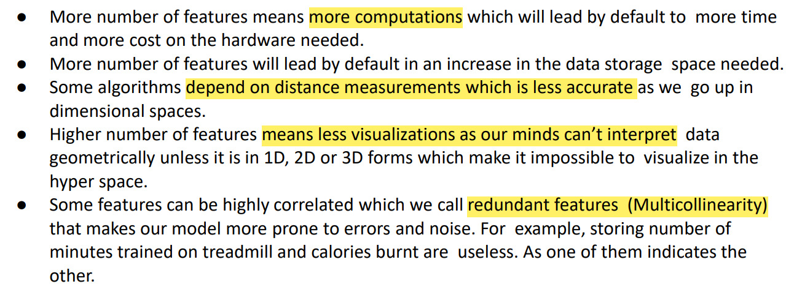

Slide 23
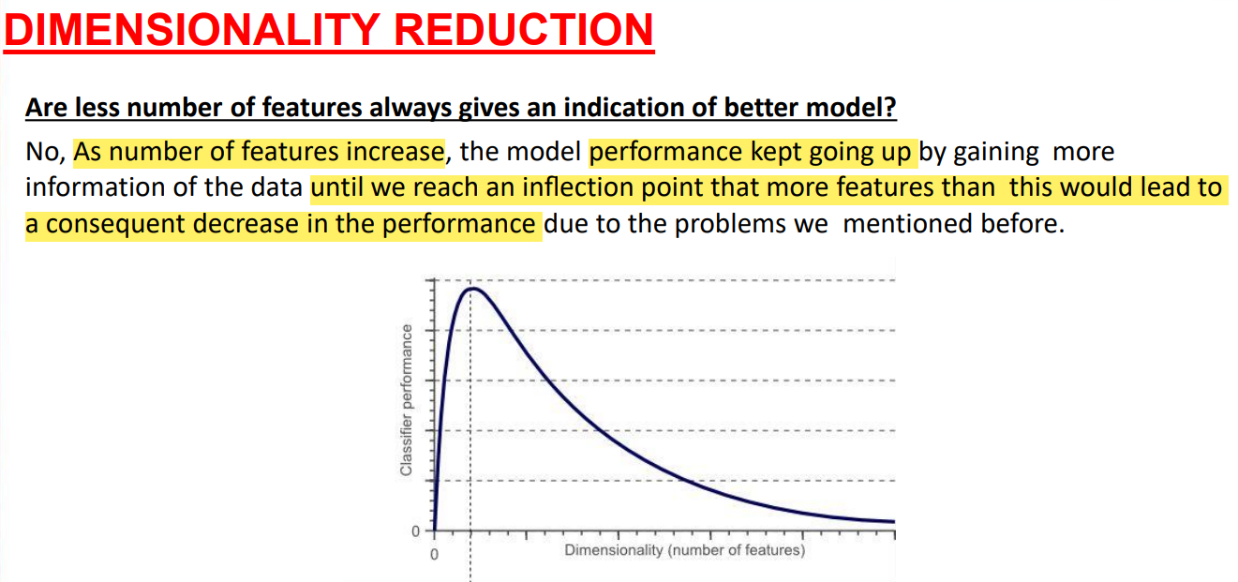

Slide 24
4. Dimensionality Reduction Techniques
These techniques reduce the number of features by transforming the data into a lower-dimensional space while retaining most of the information.
Principal Component Analysis (PCA): Transforms the data into a set of orthogonal components (principal components) that capture the maximum variance in the data.
Linear Discriminant Analysis (LDA): Similar to PCA but takes class labels into account and seeks to maximize the ratio of between-class variance to within-class variance.
t-Distributed Stochastic Neighbor Embedding (t-SNE): Primarily used for visualization, it reduces the dimensionality of the data while preserving the structure.

Slide 25
5. Unsupervised Feature Selection
In cases where the data doesn’t have labeled outcomes, unsupervised methods like clustering-based approaches can be used.
Feature Clustering: Groups similar features together and selects a representative feature from each cluster.
Autoencoders: Neural network-based techniques that learn a compressed representation of the input data and can be used for feature selection by interpreting the hidden layers.

Slide 26
Dimensionality Reduction
In many ML problems, the datasets have large # of variables Sometimes # of variables > # of observations
e.g., image processing, text analysis, time series analysis
Curse of dimensionality:
  The problem of having too many features describing an inductive learning task
  Large input features make training slow - the complexity of any classifier or regressor depends on the # of inputs
  High dimensional data - ML algorithms have some difficulty in finding a good solution
  Dimensionality Reduction: Process of reducing the # of variables by obtaining a smaller set of principal variables

Slide 27
Why Reduce Dimensions?
Faster & less complex ML process:
  Complexity of ML algorithms depends on the # of input dimensions d and size of data sample N for reduced memory & computation
  Decreasing d also decreases the complexity of the inference algorithm during testing
Saves cost:
  takes care of multicollinearity (correlation among features) - removes redundant features, improves model stability & saves the cost of extraction
Robust models:
  Simpler models are more robust on small datasets
  Have less variance, i.e., vary less
Better visualization:
  Can be plotted easily & analyzed visually for structure & outliers

Slide 28
Techniques Two Approaches
Feature Selection:
  Finding k of the total of n features that gives the most information & discarding the other (n−k) dimensions
Feature Extraction:
  Finding a new set of k features that are the combination of the original n features
  May be supervised or unsupervised (depending on whether they use the output information)
  Widely used methods: PCA (unsupervised) & LDA (supervised)

Slide 29
Feature Selection
Also referred to as subset selection, variable selection or attribute selection
Process of selecting a subset of relevant features (variables, predictors) for use in the model construction
Premise: Data contains many features (redundant or irrelevant) & can be removed without incurring much loss of information
Goal: interpretability & improved accuracy
Approaches:
  Filter: Extracts features from data with no learning involved
  Wrapper: Uses learning techniques to evaluate useful features
  Embedded: Combines the feature selection step & the classifier construction

Slide 30
Filter Methods
Uses intrinsic properties of variables, ignoring the ML method itself
Useful for classification problems where each variable adds incremental classification power
Criterion: Measure feature subset “relevance”
Search: Order features by individual feature ranking or nested subset of features
Assessment: Using statistical tests
Statistical Approaches:
  Covariance – for numeric data
  Correlation coefficient – for numeric data
  Chi-square – for nominal data
  Information gain
Advantages :
  Robust against overfitting
  Faster & computationally cheaper
Disadvantage :
  May not select most useful features

Slide 31
Feature Importance
Feature Importance:
Gives a score for each feature of the data
The higher the score, the more important or relevant the feature is to the target feature.
Feature importance is an inbuilt class that comes with tree based classifiers such as:
  Random Forest Classifiers
  Extra Tree Classifiers

Slide 32
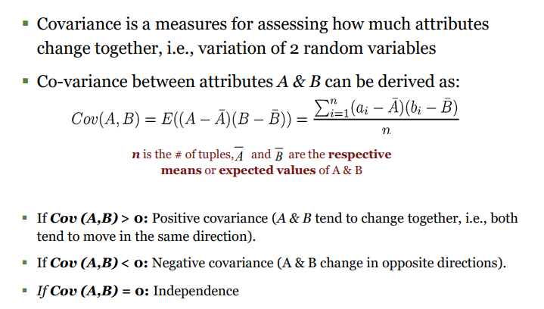
Covariance (Numerical Data)

Slide 33
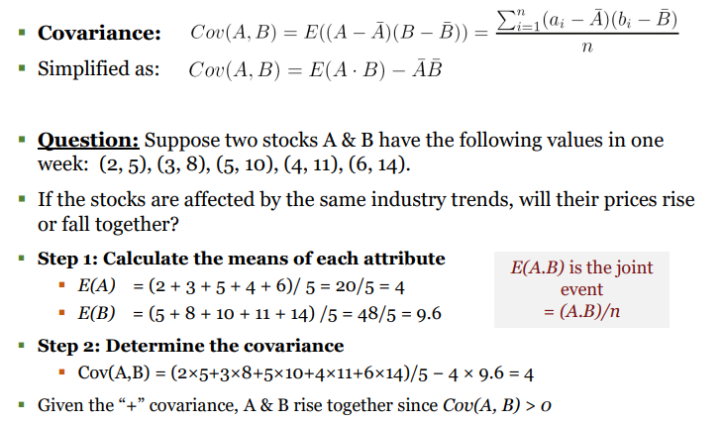
Covariance Computation

Slide 34
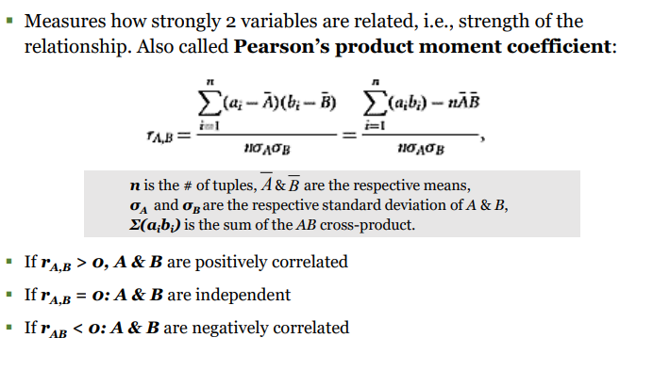
Correlation Coefficient (Numeric Data)

Slide 35
Wrapper Methods
▪ Use a search algorithm to search the space of possible feature subsets
▪ Evaluates each subset by running a model on the subset to find the optimal value
Criterion: Measure feature subset “usefulness”
Search: Search the space of all feature subsets and select the set with the highest score
Statistical Approaches: Uses a recursive approach to build multiple models with feature subsets. Choose best subset that gives the best performing model
Evaluation criterion = performance measure (Cross-validation)
  In regression, e.g., p-value, R2
  In classification: e.g., accuracy, precision, recall, f1-score

Slide 36
Wrapper Methods Approaches
Forward Selection:
Start with no variables & add them one by one
At each step, add the one that decreases the error the most, until any further addition does not decrease the error (or decreases it only sightly)
Backward Selection:
Start with the full model (including all the independent variables)
Then remove the insignificant feature with the highest p-value (> significance level)
Repeat process until we have the final set of significant features

Slide 37
Feature Extraction
Refers to a set of techniques that allows a system to automatically build features
Differs from manual feature engineering
Helps to get the best feature from data by selecting & combining variables into features, effectively reducing the amount of data
Approaches :
  Factor Analysis
  PCA
  SVD
  LDA
  Autoencoders

Slide 38
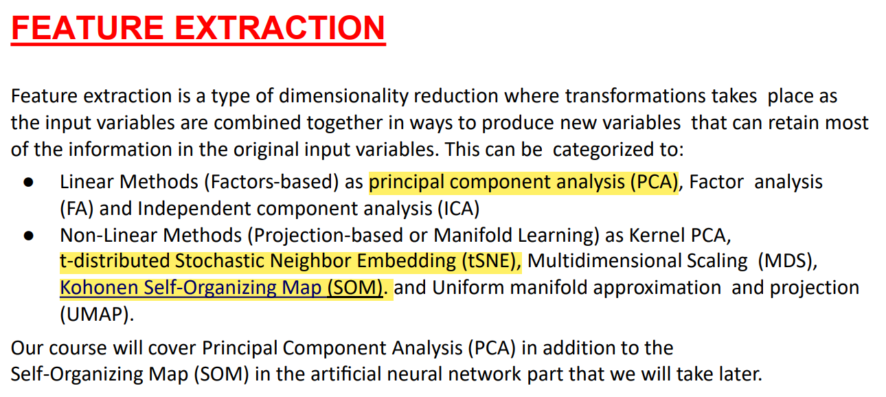

Slide 39
Global Dimensionality Reduction
Definition: technique aims to reduce the dimensionality of the entire dataset by finding a low-dimensional representation that captures the overall structure of the data. These methods consider the entire dataset and seek to preserve global structures.
Examples:
Principal Component Analysis (PCA): PCA projects the data onto a lower-dimensional subspace by finding the directions (principal components) that maximize the variance in the data. It captures the global variance structure of the data.
Linear Discriminant Analysis (LDA): LDA reduces dimensionality while maximizing class separability, considering global class distributions and variances.
Characteristics:
Global Structure: Preserves global features such as overall variance or class separation.
Linearity: Often assumes linear relationships among features (e.g., PCA).
Assumptions: Typically assumes that the data can be well-represented by linear combinations of features.

Slide 40
Local Dimensionality Reduction
Definition: techniques focus on preserving the local structure of the data. They aim to maintain relationships between nearby points in the high-dimensional space, often assuming that the data lies on a low-dimensional manifold.
Examples:
t-Distributed Stochastic Neighbor Embedding (t-SNE): t-SNE preserves local similarities between data points, focusing on the relationships between neighboring points. It is often used for visualization.
Locally Linear Embedding (LLE): LLE attempts to preserve local relationships by reconstructing data points from their neighbors and then projecting the reconstructed data into a lower-dimensional space.
Isomap: Isomap combines local and global properties by preserving distances between points on a manifold, focusing on local relationships while capturing global structure.
Characteristics:
Local Structure: Emphasizes preserving local relationships and neighborhood information.
Non-Linearity: Can capture non-linear relationships in the data.
Assumptions: Often assumes that data is distributed on or near a low-dimensional manifold.

Slide 41
PCA
PCA examines the covariance among features & combines multiple features into a smaller set of uncorrelated variables
Used to transform a higher-dimensional set of features that could be possibly correlated into a lower-dimensional set of linearly uncorrelated features
New features, which are weighted combinations of the original predictor set, are called principal components (PCs)

Slide 42
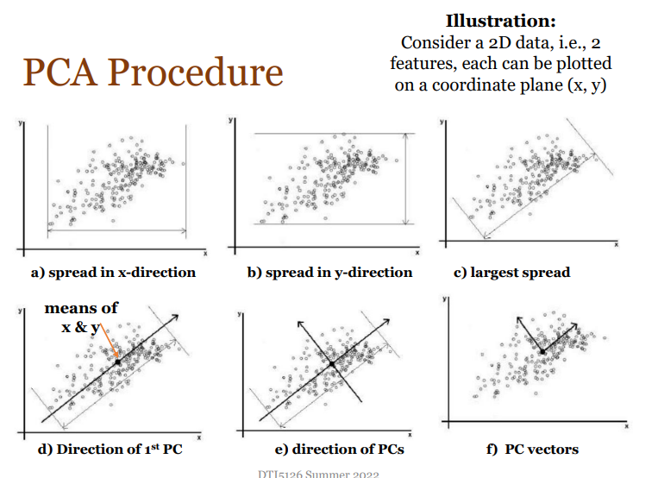
PCA Procedure

Slide 43
Principal Component Analysis (PCA):
  Algorithm:
    Standardize the data.
    Compute the covariance matrix of the data.
    Calculate the eigenvalues and eigenvectors of the covariance matrix.
    Sort the eigenvectors by eigenvalues in descending order and select the top k eigenvectors.
    Transform the data to the new k-dimensional space.
  Advantages: Simple, efficient, and widely used for data compression and visualization.
  Disadvantages: Linear method, so it may not capture complex relationships in the data.

Slide 44
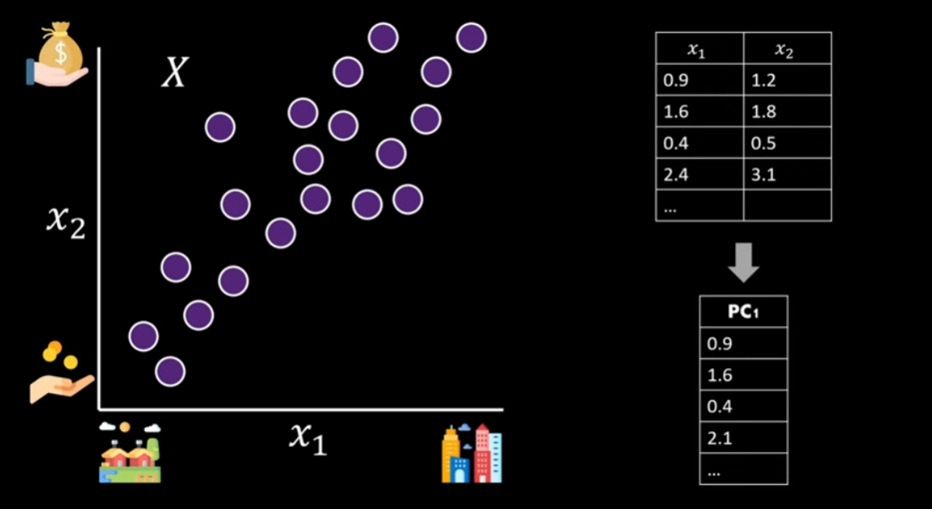
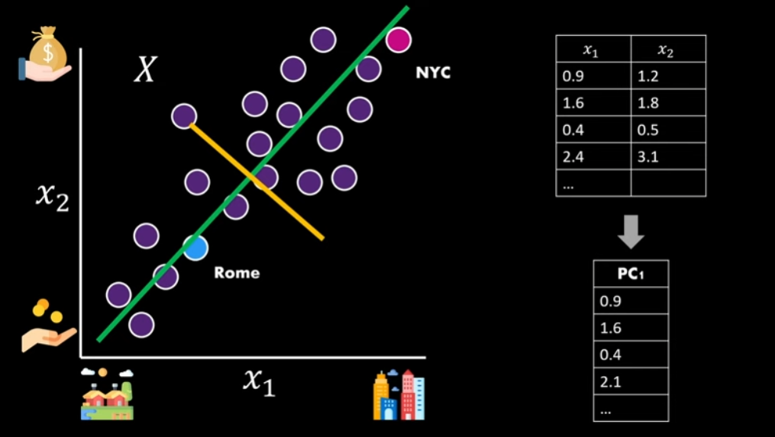
PCA

Slide 45
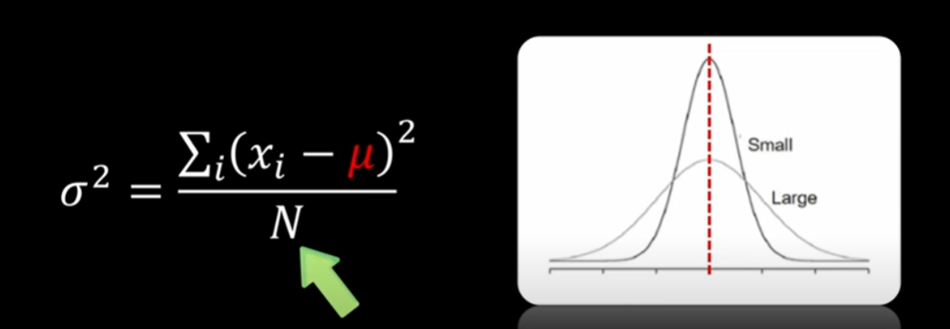
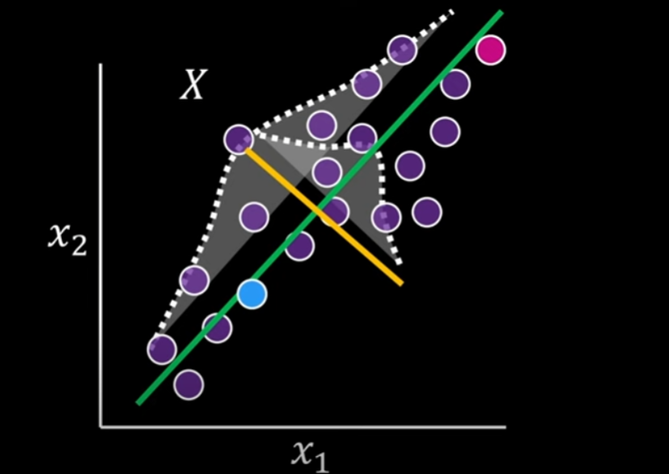
PCA

Slide 46
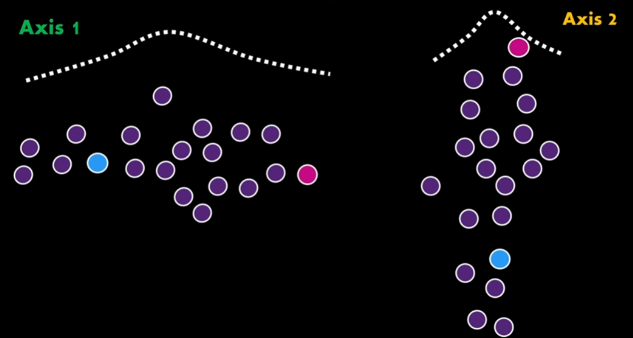
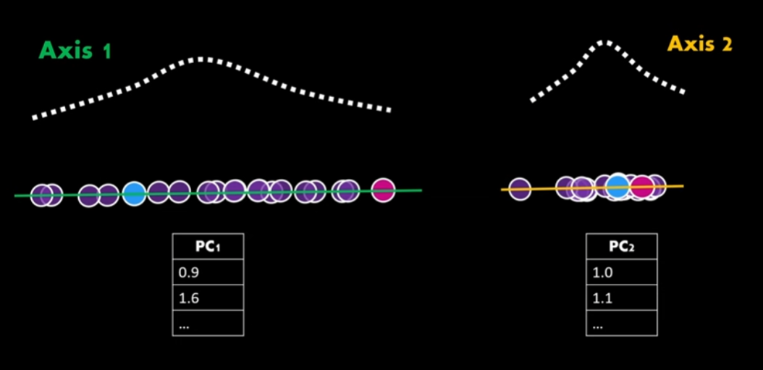
PCA

Slide 47
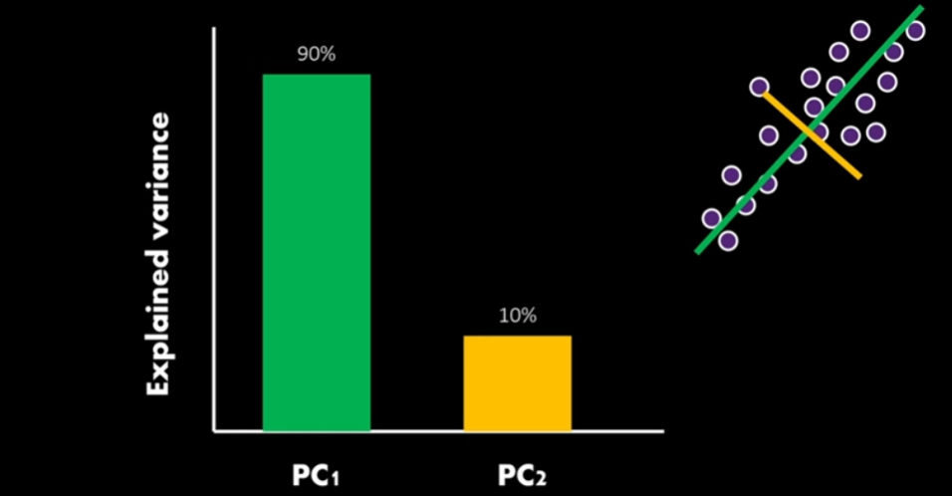
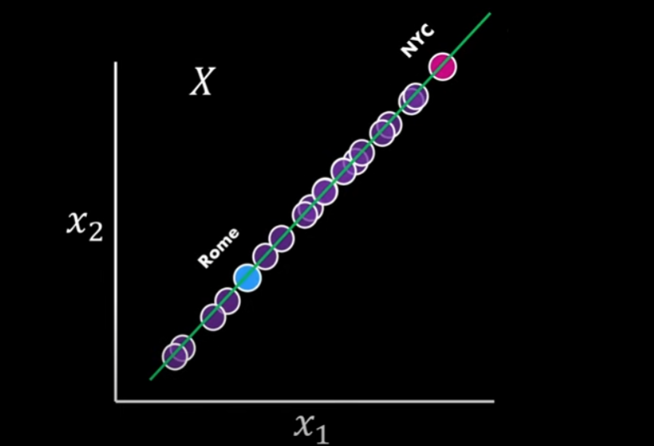
PCA

Slide 48
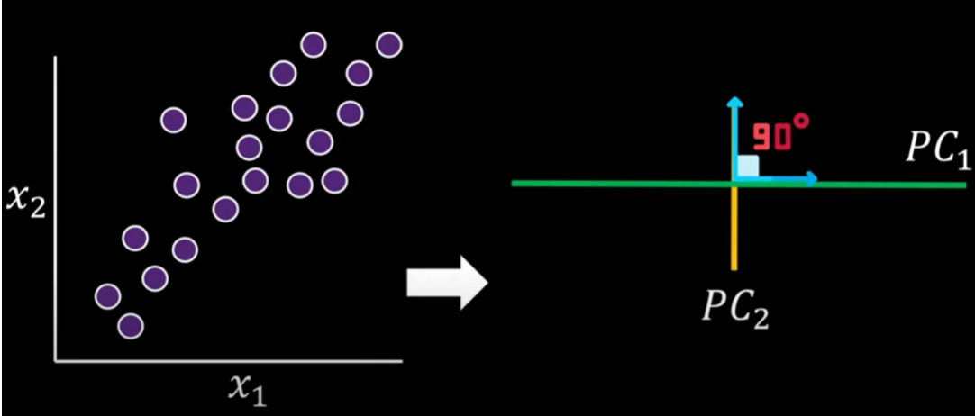
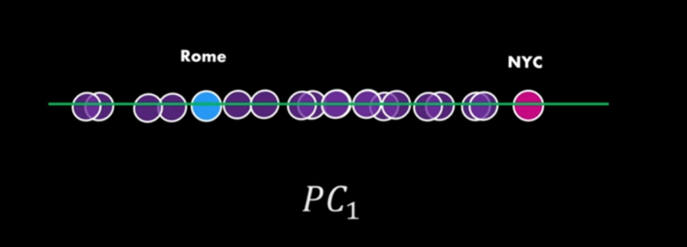
PCA

Slide 49
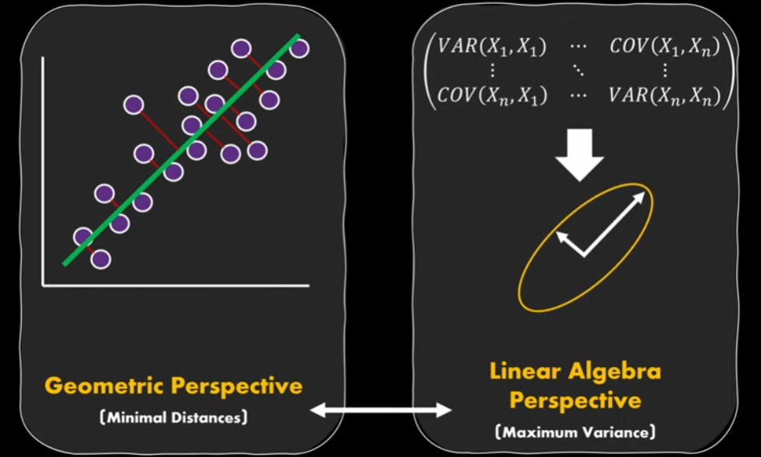
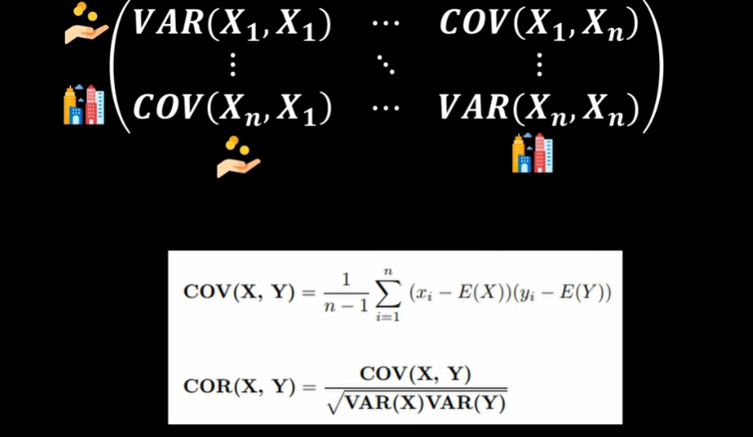
PCA

Slide 50
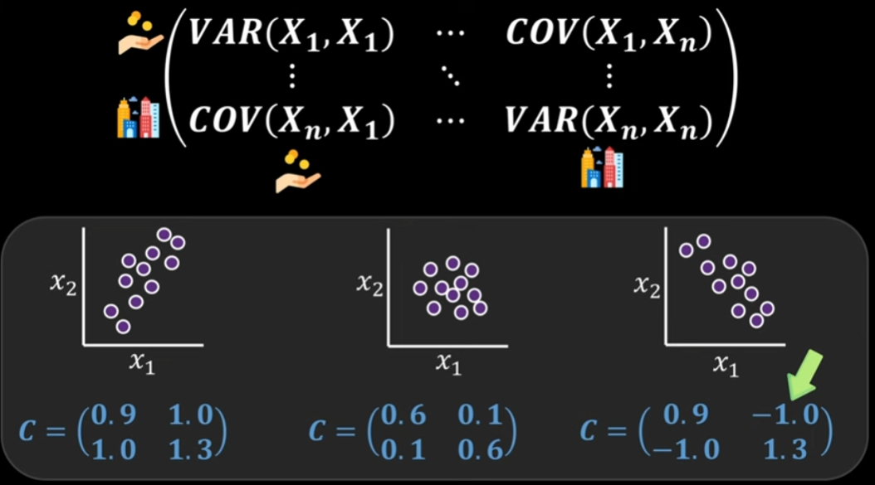
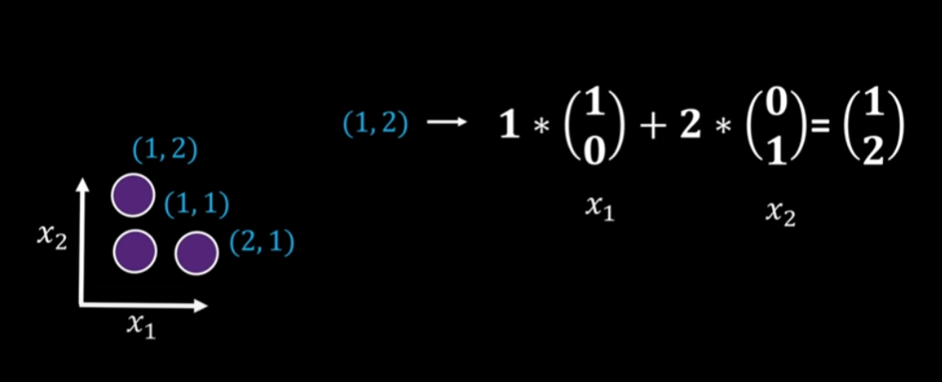
PCA

Slide 51
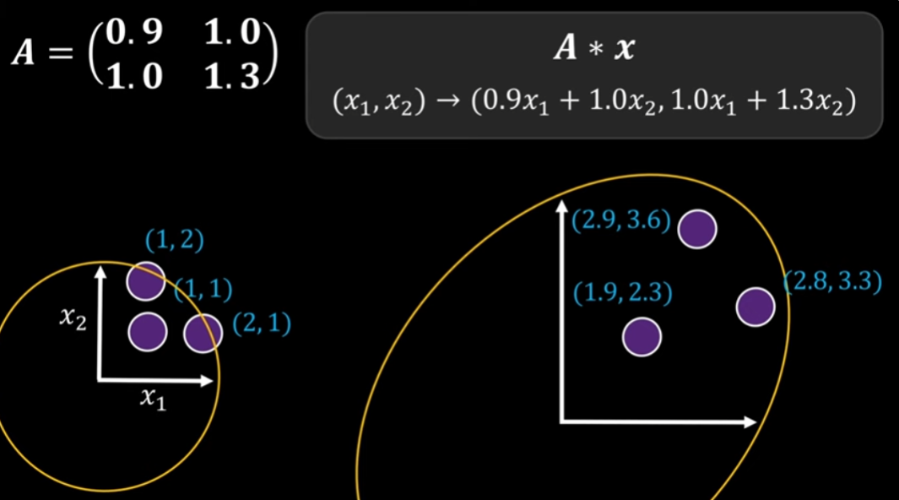
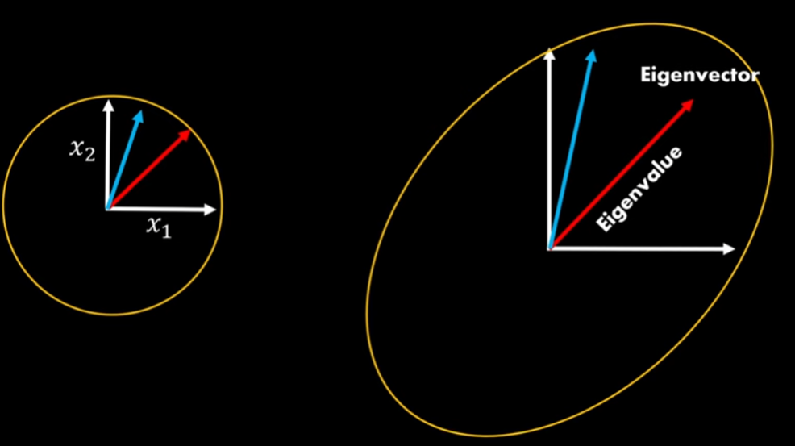
PCA

Slide 52
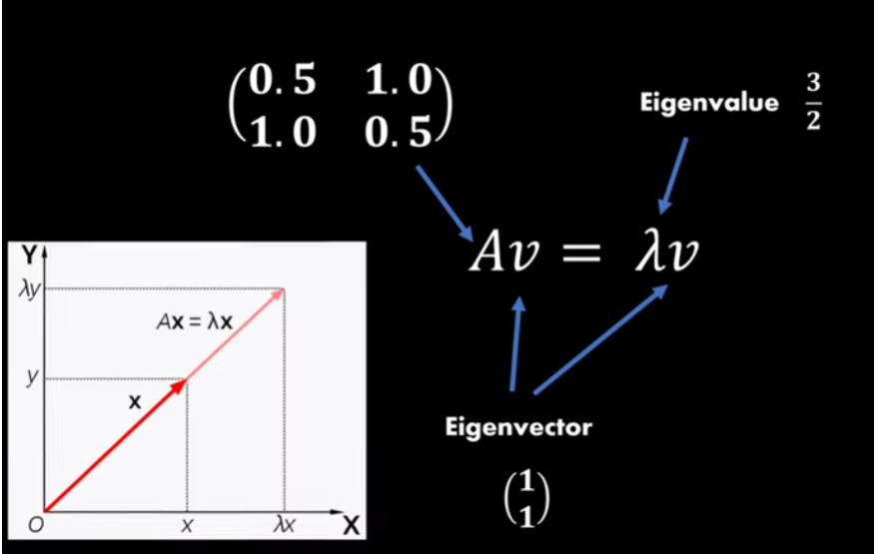
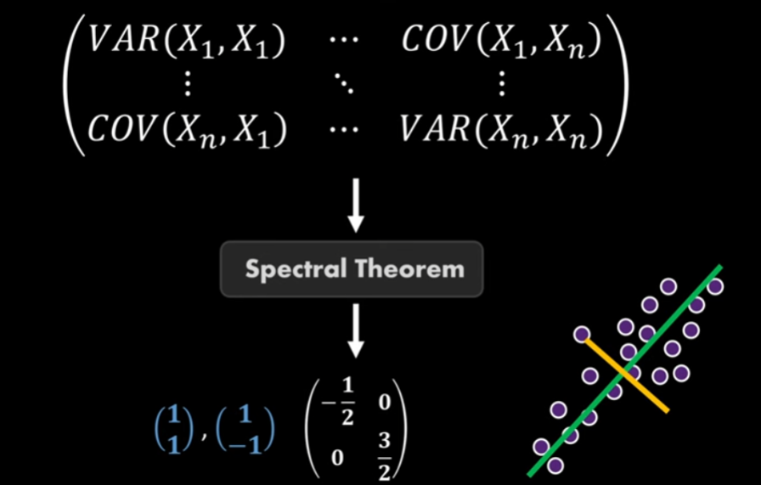
PCA

Slide 53
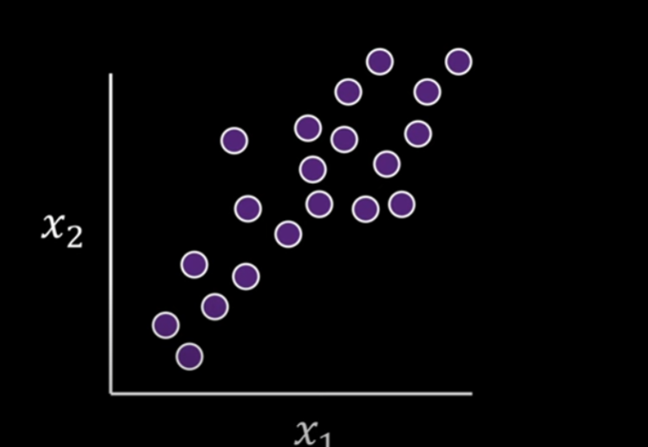
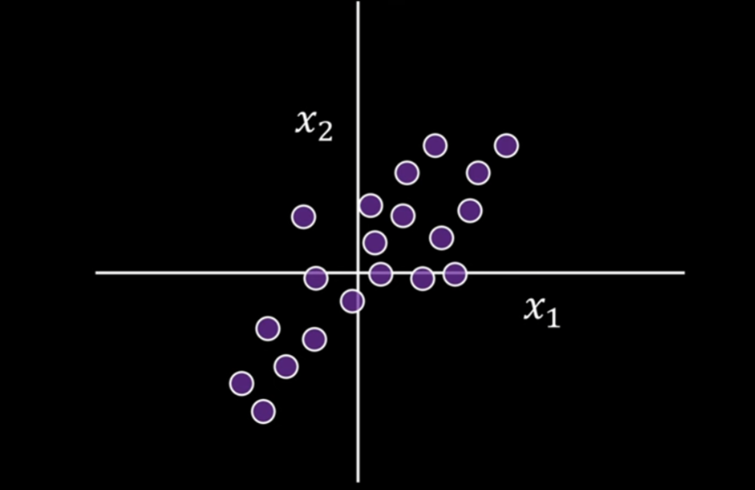
PCA

Slide 54
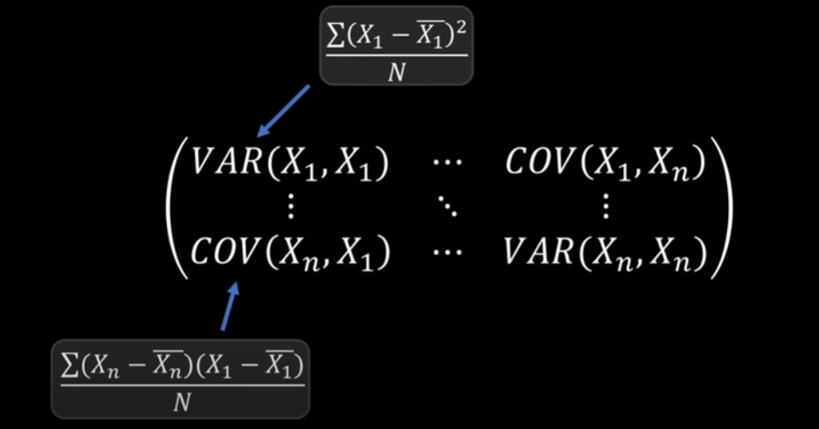
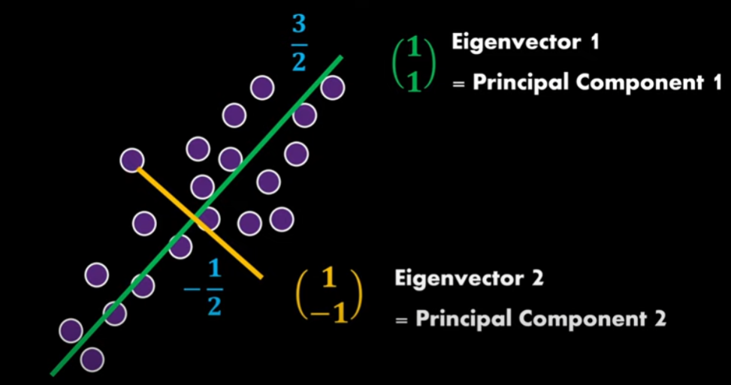
PCA

Slide 55
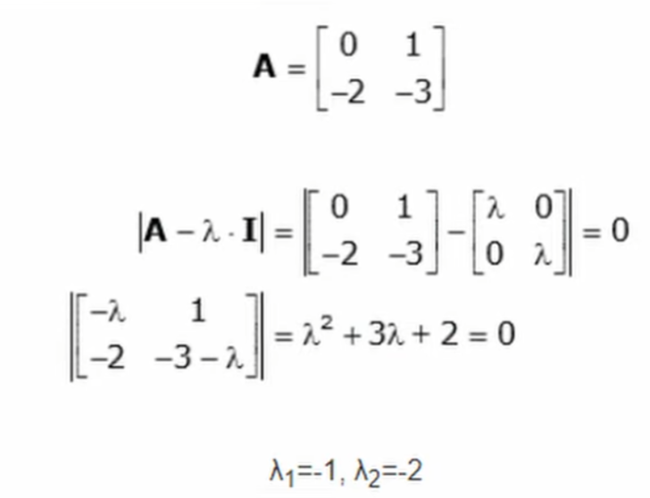
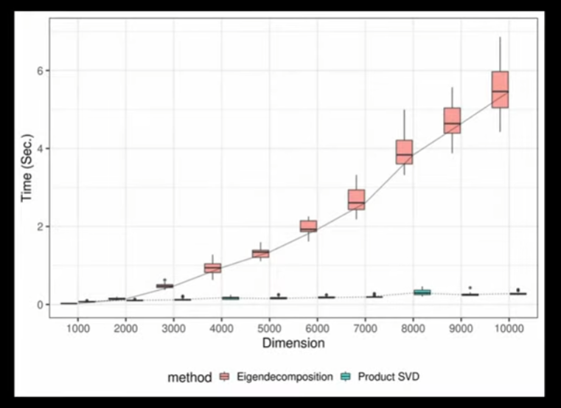
PCA

Slide 56


PCA

Slide 57


PCA

Slide 58

PCA

Slide 59

PCA

Slide 60
Linear Discriminant Analysis (LDA)
a supervised dimensionality reduction technique that is commonly used for classification tasks.
It projects the data onto a lower-dimensional space while maximizing the separation between classes.
Understanding LDA:
  Objective: LDA aims to find the linear combinations of features that best separate two or more classes. It does so by maximizing the ratio of between-class variance to the within-class variance in any particular dataset, ensuring that the classes are as separated as possible.
  Output: The output of LDA is a set of linear discriminants (new axes) onto which the data is projected.

Slide 61

Linear Discriminant Analysis (LDA)

Slide 62
Linear Discriminant Analysis (LDA)
Algorithm:
  Compute the within-class and between-class scatter matrices.
  Compute the eigenvalues and eigenvectors of the scatter matrices.
  Select the top K eigenvectors to form the new subspace.
Advantages: Useful for classification tasks, as it aims to maximize class separability.
Disadvantages: Assumes normal distribution of data and equal class covariances.

Slide 63

LDA

Slide 64

LDA

Slide 65

Summary on LDA

Slide 66

LDA example

Slide 67

LDA example

Slide 68

LDA example

Slide 69

LDA example

Slide 70

How many components to choose

Slide 71

PCA vs LDA

Slide 72

PCA vs LDA

Slide 73

PCA vs LDA

Slide 74
PCA vs LDA
1. Objective:
PCA:
  Unsupervised: PCA is an unsupervised method, meaning it does not take class labels into account.
  Maximize Variance: The main goal of PCA is to reduce the dimensionality of the data while retaining as much variance as possible. It finds the directions (principal components) along which the variance of the data is maximized.
LDA:
  Supervised: LDA is a supervised method, meaning it uses class labels during the dimensionality reduction process.
  Maximize Class Separability: LDA aims to find the linear combinations of features that best separate the classes. It tries to maximize the ratio of between-class variance to within-class variance.

Slide 75
PCA vs LDA
2. Mathematical Approach:
PCA:
  Covariance Matrix: PCA computes the eigenvectors and eigenvalues of the covariance matrix of the data. The eigenvectors corresponding to the largest eigenvalues form the principal components.
  Dimensionality Reduction: Data is projected onto the top principal components, which are orthogonal (uncorrelated) directions of maximum variance.
LDA:
  Scatter Matrices: LDA computes the within-class scatter matrix and the between-class scatter matrix. It then solves the generalized eigenvalue problem to find the eigenvectors that maximize the separation between classes.
  Dimensionality Reduction: Data is projected onto the linear discriminants, which maximize class separability.

Slide 76
PCA vs LDA
3. Key Differences:
Focus:
  PCA: Focuses on finding directions that capture the most variance in the data, without considering any class labels.
  LDA: Focuses on finding directions that best separate different classes, using class labels.
  Dimensionality Reduction:
  PCA: The number of principal components can be as large as the number of features, but typically fewer components are chosen based on the variance explained.

Slide 77
PCA vs LDA
Data Assumptions:
PCA: No assumptions are made about the data distribution.
LDA: Assumes that the data is normally distributed and that classes have the same covariance matrix
(homoscedasticity).
Interpretability:
PCA: Principal components may not be easily interpretable in terms of original features.
LDA: Linear discriminants are interpretable as they are formed based on class labels,
but the interpretation depends on the data distribution.

Slide 78
PCA vs LDA
4. Applications:
PCA:
  Data Visualization: PCA is often used for visualizing high-dimensional data in 2D or 3D.
  Noise Reduction: PCA can be used to reduce noise by discarding components with low variance.
  Preprocessing: Used as a preprocessing step to reduce the dimensionality before applying machine learning algorithms.
LDA:
  Classification: LDA is often used for feature extraction in classification tasks where it can improve class separability.
  Face Recognition: LDA has been used in computer vision, particularly in face recognition, to reduce the dimensionality while enhancing class separability.
  Preprocessing: Like PCA, LDA can also be used as a preprocessing step, but specifically when the target is to classify the data

Slide 79
PCA vs LDA
5. Example Scenarios:
Use PCA when:
  You have no class labels or want to reduce dimensionality based on variance.
  You need to visualize the data or remove noise.
Use LDA when:
  You have labeled data and your goal is to maximize class separability.
  You are preparing data for a classification task.
Summary
PCA is an unsupervised technique that focuses on capturing the maximum variance in the data without considering class labels, and is primarily used for exploratory data analysis, noise reduction, and as a preprocessing step.
LDA is a supervised technique that focuses on maximizing class separability, making it particularly useful for classification tasks.

Slide 80
t-Distributed Stochastic Neighbor Embedding (t-SNE)
Algorithm:
  Compute pairwise similarities between data points in high-dimensional space.
  Compute pairwise similarities in a low-dimensional space.
  Minimize the divergence between the high-dimensional and low-dimensional similarities.
Advantages: Effective for visualizing high-dimensional data in 2D or 3D, preserving local structure.
Disadvantages: Computationally expensive and can be sensitive to hyperparameters.

Slide 81

T-SNE

Slide 82

T-SNE

Slide 83

T-SNE

Slide 84


T-SNE

Slide 85


T-SNE

Slide 86

T-SNE

Slide 87

T-SNE

Slide 88


T-SNE

Slide 89

T-SNE

Slide 90


T-SNE

Slide 91

T-SNE

Slide 92


T-SNE

Slide 93

T-SNE

Slide 94

T-SNE

Slide 95

T-SNE

Slide 96

T-SNE

Slide 97


T-SNE

Slide 98


T-SNE

Slide 99

T-SNE

Slide 100

T-SNE

Slide 101

T-SNE

Slide 102

T-SNE

Slide 103

T-SNE

Slide 104

PCA vs T-SNE

